Slide 1
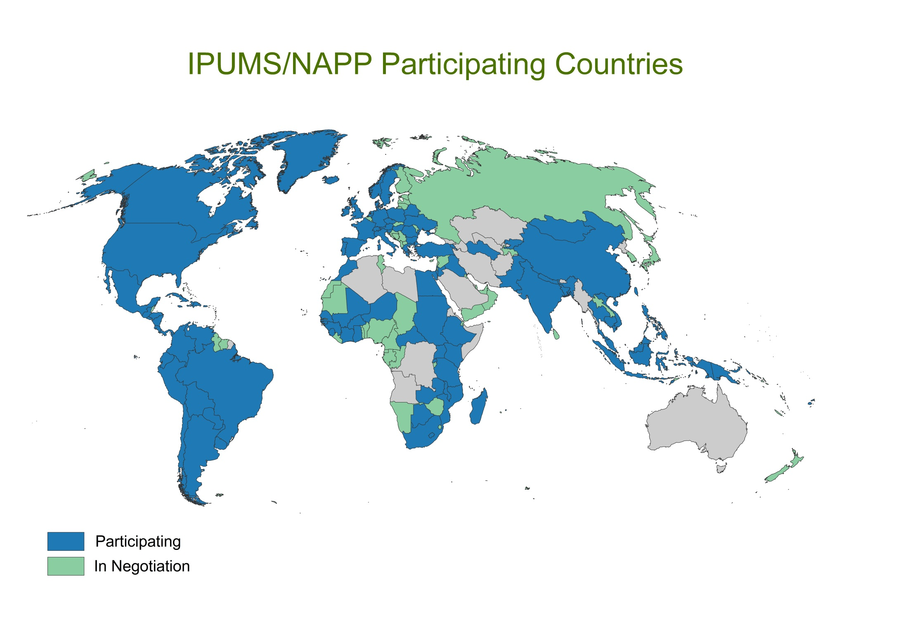
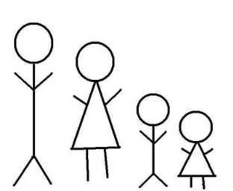
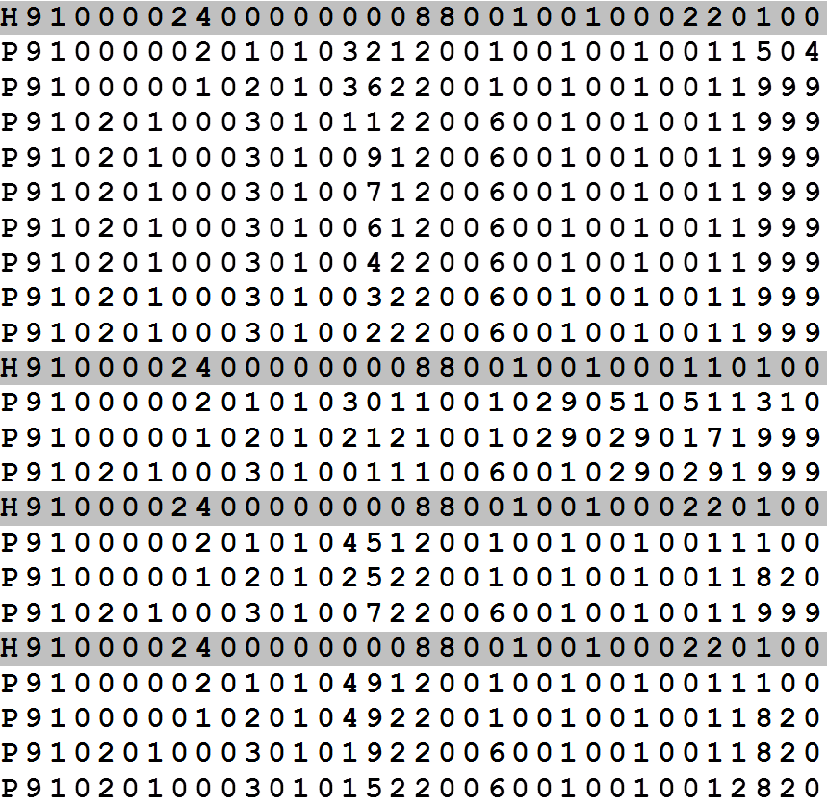
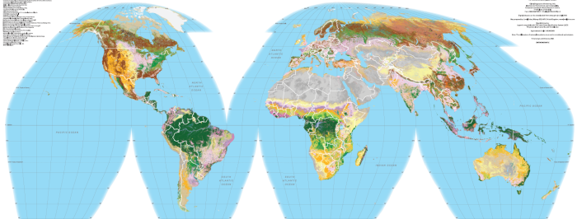
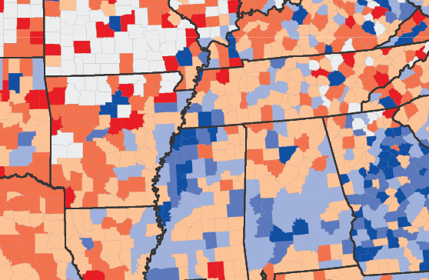
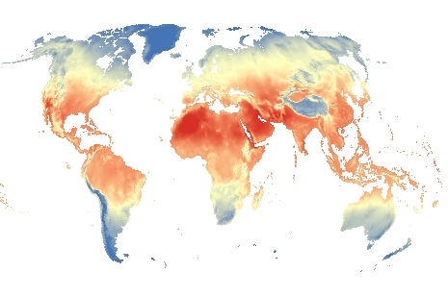
Terra Populus Data Domains
Population
Environment
Microdata
Land cover
Individuals and households
Land use
Areal Data
Climate
Notes:
Disparate scientific domains – interrelated processes
Multiple data formats

Slide 2
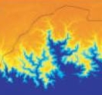
Location-Based Integration
Individuals and households
with their environmental
and social context
Summarized population and environmental characteristics for administrative districts
County ID | Mean Ann. Temp. | Max. Ann. Precip. | Rent, Rural | Rent, Urban | Own, Rural | Own, Urban
G17003100001 | 21.2 | 768 | 3129 | 1063 | 637 | 365
G17003100002 | 23.4 | 589 | 2949 | 1075 | 1469 | 717
G17003100003 | 24.3 | 867 | 3418 | 1589 | 1108 | 617
G17003100004 | 21.5 | 943 | 1882 | 425 | 202 | 142
G17003100005 | 24.1 | 867 | 2416 | 572 | 426 | 197
G17003100006 | 24.4 | 697 | 2560 | 934 | 950 | 563
G17003100007 | 25.6 | 701 | 2126 | 653 | 321 | 215
Rasters of population and environment data
Notes:
Integration across domains, formats hinges on geography
Users get any type of data in format useful to them
Requires boundary files, boundaries harmonized over time

